Slide 1
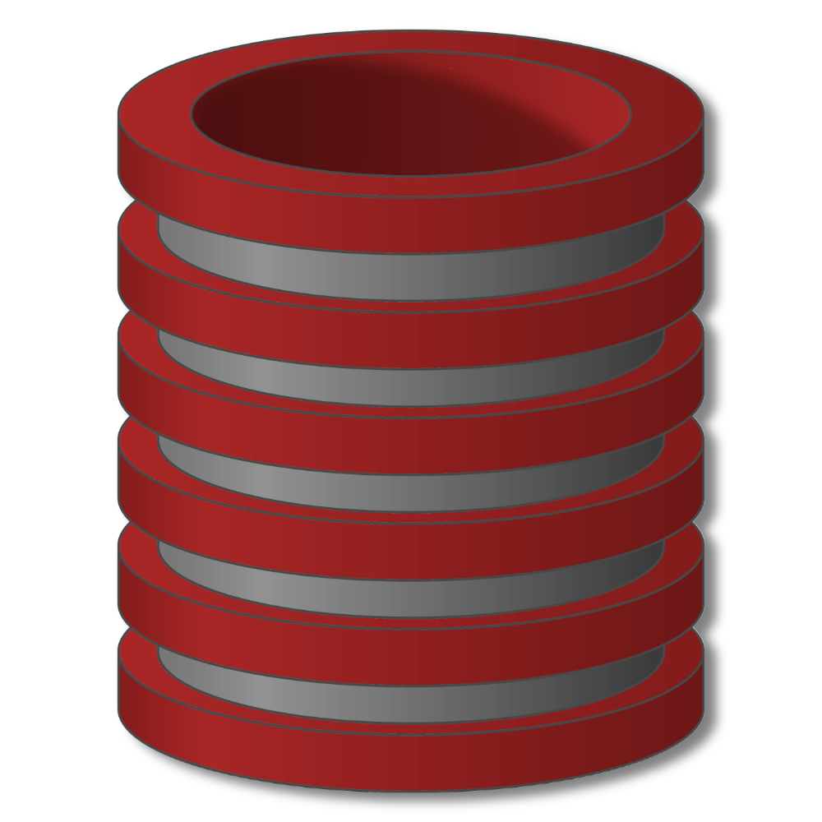
On-Line Analytical Processing (OLAP)
Introduction

Slide 2
Two broad types of database activity
OLTP – Online Transaction Processing
Short transactions
Simple queries
Touch small portions of data
Frequent updates
OLAP – Online Analytical Processing
Long transactions
Complex queries
Touch large portions of the data
Infrequent updates

Slide 3
OLAP Vs. OLTP
OLTP (On Line Transaction Processing)
Select tx_date, balance from tx_table
Where account_ID = 23876;

Slide 4
OLAP Vs. OLTP
OLAP
Select balance, age, sal, gender from customer_table, tx_table
Where age between (30 and 40) and
Education = ‘graduate’ and
CustID.customer_table = Customer_ID.tx_table;

Slide 5
Why a Data Warehouse?
DBMS Approach
List of all items that were sold last month?
List of all items purchased by a customer?
The total sales of the last month grouped by branch?
How many sales transactions occurred during the month of January?
Notes:
Let’s take a close look at the typical queries for a DBMS. They are either about listing the contents of tables or running aggregates of values i.e. rather simple and straightforward queries and fairly easy to program. The queries follow rather pre-defined paths into the database and are unlikely to come up with something new or abnormal.

Slide 6
Why a Data Warehouse?
Intelligent Enterprise
Which items sell together? Which items to stock?
Where and how to place the items? What discounts to offer?
How best to target customers to increase sales at a branch?
Which customers are most likely to respond to my next promotional campaign, and why?

Slide 7
Why a Data Warehouse?
Businesses want much more…
What happened?
Why it happened?
What will happen?
What is happening?
What do you want to happen?
Stages of
Data Warehouse
Notes:
What will happen→ Use modeling to predict future
These questions primarily point to what is called as the different stages of a Data
Warehouse i.e. starting from the first stage, and going all the way to stage 5. The first
stage is not actually a data warehouse, but a pure batch processing system. Note that as
the stages evolve the amount of batching processing decreases, this being maximum in
the first stage and minimum in the last or 5th stage. At the same time the amount of adhoc query processing increases. Finally in the most developed stage there is a high level of event based triggering. As the system moves from stage-1 to stage-5 it becomes what is called as an active data warehouse.

Slide 8
What is a Data Warehouse?
A complete repository of historical corporate data extracted from transaction systems that is available for ad-hoc access by knowledge workers.
Notes:
45

Slide 9
What is a Data Warehouse?
Complete repository
All the data is present from all the branches/outlets of the business.
Even the archived data may be brought online.
Transaction System
Management Information System (MIS)
Could be typed sheets (NOT transaction system)
Ad-Hoc access
Dose not have a certain access pattern
Queries not known in advance
Difficult to write SQL in advance
Knowledge workers
Typically NOT IT literate (Executives, Analysts, Managers).
NOT clerical workers.
Decision makers
Notes:
45

Slide 10
More terminology
Data warehousing
Bring data from operational (OLTP) sources into a single “warehouse” for (OLAP) analysis
Decision support system (DSS)
Infrastructure for data analysis
E.g., data warehouse tuned for OLAP

Slide 11
Where does OLAP fit in?


?
Data
Loading
Reports

DWH
Decision
Maker
OLAP
Data Cube
Presentation
Tools
Transaction
Data
Notes:
shows that using the transactional databases (after Extract Transform Load)
OLAP data cubes are generated. Over here multidimensional cube is shown i.e. a
MOLAP cube. Data retrieved as a consequence of exploring the MOLAP cube is then
used as a source to generate reports or charts etc. Actually in typical MOLAP
environments, the results are displayed as tables, along with different types of charts, such
as histogram, pie etc.

Slide 12
How DW is Different?
Does not follows the traditional development model
Requirements

Program
Classical SDLC
Requirements gathering
Analysis
Design
Programming
Testing
Integration
Implementation

Notes:
46

Slide 13
How DW Different?
Does not follows the traditional development model
DWH
Program
DWH SDLC (CLDS)
Implement warehouse
Integrate data
Test for biasness
Program w.r.t data
Design DSS system
Analyze results
Understand requirement

Requirements
Notes:
46
User don’t know initially what question they need to know
Data biasness: some unusual data spikes e.g user did not enter age in registration form and by default value is 0000

Slide 14
Modeling Technique
The entity-relationship data model is commonly used in the design of relational databases:
Where a database schema consists of a set of entities and the relationships between them. Such a data model is appropriate for online transaction processing.
A data warehouse, requires a concise, subject-oriented schema that facilitates online data analysis.
The most popular data model for a data warehouse is a dimensional model.

Slide 15
What is Dimensional Modeling
A simpler logical model optimized for decision support systems.
Inherently dimensional in nature, with a single central fact table and a set of smaller dimensional tables.
Results in a star like structure, called star schema or star join.
All relationships mandatory 1-M.
Single path between any two levels.
Supports ROLAP operations.

Slide 16
OLAP: Facts & Dimensions
The foundation for OLAP is dimensional modeling techniques which focus on the concepts of “facts” and “dimensions” for organizing data.
FACTS: Quantitative values (numbers) or “measures.”
e.g., units sold, sales $, Cº, Kg etc.
DIMENSIONS: Perspectives or entities with respect to which an organization wants to keep records.
Descriptive categories.
e.g., time, geography, product etc.
DIM often organized in hierarchies representing levels of detail in the data
e.g., week, month, quarter, year, decade etc.
Notes:
Facts are the quantities, numbers that can be aggregated (e.g., sales $, units sold etc.) that
we measure and dimensions are how we filter/report on the quantities (e.g., by geography,
product, date, etc.).

Slide 17
“Star Schema”
Fact table
Contains measurements, metrics, and facts about a business process
Updated frequently, often append-only, very large
Dimension tables
Contains detailed data to be used constraining queries for the fact table
Updated infrequently, not as large
“We need monthly sales
volume and price by
week, product and Zone”
Fact
Dimensions

Slide 18
Star Schema Example
Star schema:
- One fact table in the center
- Multiple dimension tables
- Represents one data cube
- DW may contain many star schemas

Slide 19
Constellation Schema Example
Constellation schema:
Multiple fact tables
Dimension tables share fact tables
Relationship diagram looks like a constellation
Notes:
Constellation schema:
- Multiple fact tables
- Dimension tables share fact tables
- Relationship diagram looks like a constellation

Slide 20
Snowflake Schema Example
Snowflake schema:
- Multiple levels of dimension tables
- Use when dimension tables are small: little performance gain by deformalizing
- Relationship diagram looks like a snowflake

Slide 21
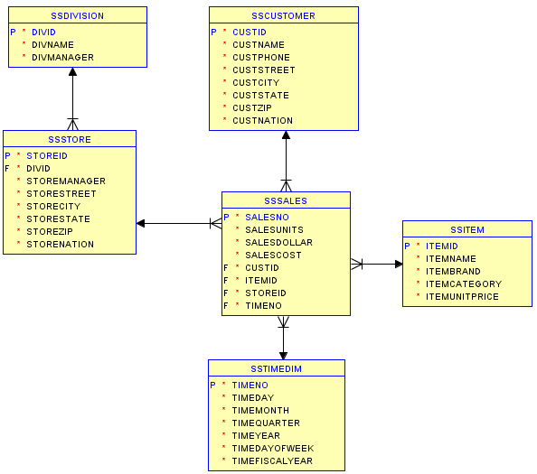
Oracle Diagram for the Store Sales DW
Notes:
SS prepended to the table names to avoid table name conflicts in my schema

Slide 22
Star Schema – fact table references dimension tables
Sales(storeID, itemID, custID, qty, price)
Store(storeID, city, state)
Item(itemID, category, brand, color, size)
Customer(custID, name, address)
TimeDim(Timeday, timeMonth,…)

Slide 23
OLAP queries
Join → Filter → Group → Aggregate
Performance
Inherently very slow:
special indexes, query processing techniques
Sales(storeID, itemID, custID, qty, price)
Store(storeID, city, state)
Item(itemID, category, brand, color, size)
Customer(custID, name, address)

Slide 24
Data Cube (a.k.a. multidimensional OLAP)
Complete set of subtotals
Dimension data forms axes of “cube”
Fact (dependent) data in cells
Aggregated data on sides, edges, corner

Slide 25
Aggregations in MOLAP
Sales volume as a function of (i) product, (ii) time, and (iii) geography
A cube structure created to handle this.
Dimensions: Product, Geography, Time
Geog
S
W
E
Hierarchical summarization paths
N
Industry
Category
Product
23
Province
Division
District
City
Zone
Year
Quarter
Month Week
Day
Milk
Bread
Eggs
Butter
Jam
Juice
8
Product
45
13
12
10
w1 w2 w3 w4 w5 w6
Time
Notes:
As already stated a number of times, in a Data Warehouse decision support environment
we are interested in the big picture, we want to look at the data from a macro level instead
of the micro level. For a macroscopic view aggregates are used. In this example we look
at the sales volume i.e. number of items sold as a function of product, time and
geography. Note that all three of them are dimensions. The proceed with the analysis, a
cube structure will be first created such that each dimension of the cube will correspond
to each identified dimension, and within each dimension will be the corresponding
hierarchy. The example further shows how the dimensions are “rolled-out” i.e. Province
into divisions, then division into district, then district into city and finally cities into
zones. Note that weeks could be rolled into a year and at the same time months can be
rolled into quarters and quarters rolled into years

Slide 26
ROLAP as a “Cube”
OLAP data is stored in a relational database (e.g. a star schema)
The fact table is a way of visualizing as a “un-rolled” cube.
So where is the cube?
It’s a matter of perception
Visualize the fact table as an elementary cube.
Geog.
Fact Table
Month
Product
Zone
Sale K Rs.
M1
P1
Z1
250
Product
M2
P2
Z1
500
Time
Notes:
The question is “how to convert something into a cube” which is intrinsically not a cube. And
more importantly, if MOLAP has the space requirement limitations, and to overcome
those limitations we are using a different implementation, then wouldn't the conversion
back to a “cube” defeat the purpose? This is actually a very good question, and needs
some detailed explanation. Fig- shows two rows of a fact table, and the aggregates
corresponding to the cells of the fact table are shown correspondingly in a three
dimensional cube. Extending this argument, each and every cell of the fact table can have
a corresponding mapping. To clarify this further, consider the analogy of the map of the
world. Our planet earth is NOT flat, it is spherical in nature i.e. three dimensional, yet the
map of the earth is flat i.e. two dimensional in nature i.e. there is a mapping from 3D
space to 2D space. If you look closely at the map, you will see that the map is divided
into a grid based on longitude and latitude, and the corresponding cells or rectangles are
not of the same size. Similarly a 2D table can be considered to be a mapping or
representation of a multi-dimensional cube or vice-a-versa.

Slide 27
How to create “Cube” in ROLAP
Cube is a logical entity containing values of a certain fact at a certain aggregation level at an intersection of a combination of dimensions.
The following table can be created using 3 queries
Month_ID
SUM (Sales_Amt) | M1 | M2 | M3 | ALL
P1
P2
P3
Total
Product_ID
Notes:
When we talked of a cube for a MOLAP, it was not actually a physical cube, but was a
logical entity. We continue with that concept, and assume that what was stored in a cube
at a certain combination of indexes, corresponding to such a group of indices, we store
the aggregates in a two dimensional table, and we use such groups of tables to store the
same data that was stored in a MOLAP. The table shown in fig-12.2 is divided into three
parts shown shaded and also shown by dotted lines. Corresponding to each part of the
table, there is a query and consequently the table can actually be filled using three SQL
queries as follows:

Slide 28
How to create “Cube” in ROLAP using SQL
For the table entries, without the totals
SELECT S.Month_Id, S.Product_Id, SUM(S.Sales_Amt)
FROM Sales
GROUP BY S.Month_Id, S.Product_Id;
For the row totals
SELECT S.Product_Id, SUM (Sales_Amt)
FROM Sales
GROUP BY S.Product_Id;
For the column totals
SELECT S.Month_Id, SUM (Sales)
FROM Sales
GROUP BY S.Month_Id;
Notes:
using these three
queries, we create a ROALP structure for previous table

Slide 29
CUBE / GROUP BY Comparison
SELECT State, Month, SUM(Sales)
GROUP BY CUBE(State, Month)
SELECT State, Month, SUM(Sales)
GROUP BY State, Month
State | Month | SUM(Sales)
CA | Dec | 100
CA | Feb | 75
CO | Dec | 150
CO | Jan | 100
CO | Feb | 200
CN | Dec | 50
CN | Jan | 75
CA | - | 175
CO | - | 450
CN | - | 125
- | Dec | 300
- | Jan | 175
- | Feb | 275
- | - | 750
State | Month | SUM(Sales)
CA | Dec | 100
CA | Feb | 75
CO | Dec | 150
CO | Jan | 100
CO | Feb | 200
CN | Dec | 50
CN | Jan | 75
The CUBE operator clause produces all possible subtotal combinations in addition to the normal totals shown in a GROUP BY clause.
Notes:
29
Partial syntax
Additional subtotal rows
Month totals: 3 rows
State totals: 3 rows
Grand total: 1 row

Slide 30
CUBE / GROUP BY Comparison
Select CUSTID, STOREID, SUM(SALESDOLLAR)
from SSSALES
group by CUSTID, STOREID;
Select CUSTID, STOREID, SUM(SALESDOLLAR)
from SSSALES
group by CUBE (CUSTID, STOREID)
order by CUSTID, STOREID;

Slide 31
CUBE Example
Summarize (sum, min, and count) store sales for USA and Canada in 2016 by store zip code and month
Generate all possible subtotals by zip code and month
SELECT StoreZip, TimeMonth, SUM(SalesDollar) AS SumSales,
MIN(SalesDollar) AS MinSales, COUNT(*) AS RowCount
FROM SSSales, SSStore, SSTimeDim
WHERE SSSales.StoreId = SSStore.StoreId
AND SSSales.TimeNo = SSTimeDim.TimeNo
AND (StoreNation = 'USA' OR StoreNation = 'Canada')
AND TimeYear = 2016
GROUP BY CUBE (StoreZip, TimeMonth)
ORDER BY StoreZip, TimeMonth;
Notes:
The CUBE operator clause produces all possible subtotal combinations in addition to the normal totals shown in a GROUP BY clause. Because all possible subtotals are generated, the CUBE operator is appropriate to summarize columns from independent dimensions rather than columns representing different levels of the same dimension. For example, the CUBE operator would be appropriate to generate subtotals for all combinations of month, store state, and item brand. In contrast, a CUBE operation to show all possible subtotals of year, month, and day would have limited interest because of the hierarchy in the time dimension.
This example shows a CUBE of two independent dimensions (StoreZip and TimeMonth). The result will contain subtotals for each column value and a grand total.
Query formulation questions
What tables: SSSales, SSStore, and SSTimeDim
How combined: by join conditions PK-FK
Individual rows versus groups of rows: row summaries on StoreZip and TimeMonth

Slide 32
CUBE Operator Calculations
GROUP BY CUBE(Col1, Col2)
M unique values in Col1
N unique values in Col2
Result rows
Maximum of M × N rows: GROUP BY Col1, Col2
Maximum subtotal rows of M + N + 1 (CUBE)
Subtotal groups
Three groups of subtotal rows (Col1, Col2, grand total)
Notes:
32
GROUP BY: max number of rows is M * N; null cells do not appear in the GROUP BY result
M, N, and P unique values per column
SELECT blocks:
Normal group by: all three columns: <Col1,Col2,Col3>
Combinations of 3 taken two at time: <Col1,Col2>, <Col1,Col3>, <Col2,Col3>
Combinations of 3 taken one at a time: <Col1>, <Col2>, <Col3>
Grand total: <>
Additional SELECT blocks: 2^{NC} – 1 where NC is the number of grouping columns

Slide 33
Cube operations
Rollup: summarize data
e.g., given sales data, summarize sales for last year by product category and region
Drill down: get more details
e.g., given summarized sales as above, find breakup of sales by city within each region
Slice and dice: select and project
e.g.: Sales of soft-drinks in any city during last quarter
Notes:
In the rollup operation the level of aggregation
is increased i.e. data is presented at a higher level of aggregation with less detail. For
example while looking at the weekly sales data, the decision maker decides to look at the
monthly sales data, this is a rollup operation. On the other hand, while looking at the
weekly sales data, the decision makers wants to look at the higher level of detail thus
he/she drills down and looks at the daily sales data or was looking at the division level of
the sales data, and drills down into district level sales data by looking at the sales in
different cities corresponding to a district, among one of the many districts present in a
division. Slice and dice is a combination of looking at a subset of data based on more than
one dimension. As shown sin the slide, a combination of geography and time is used to
look at part of the cube across more than a singe dimension. Finally pivoting is changing
the view of the data i.e. replacing the dimension across the (say) x-axis. This will become
clear when we look at specific examples in the following slides

Slide 34
ROLLUP Operator Characteristics
Partial set of subtotals
Appropriate for hierarchical dimensions
Order dependent, coarsest to finest

Slide 35
ROLLUP/GROUP BY Comparison
SELECT Year, Month, SUM(Sales)
GROUP BY ROLLUP(Year, Month)
SELECT Year, Month, SUM(Sales)
GROUP BY Year, Month
Year | Month | SUM(Sales)
2016 | Jan | 100
2016 | Feb | 75
2016 | Mar | 150
2017 | Jan | 100
2017 | Feb | 200
2017 | Mar | 50
2016 | - | 325
2017 | - | 350
- | - | 675
Year | Month | SUM(Sales)
2016 | Jan | 100
2016 | Feb | 75
2016 | Mar | 150
2017 | Jan | 100
2017 | Feb | 200
2017 | Mar | 50
Notes:
35
Partial syntax
Additional subtotal rows
State subtotals: 3 rows
Grand total: 1 row
No subtotals for Month because it is the innermost column in rollup list

Slide 36
ROLLUP Example
Summarize (SUM, COUNT, and MIN) store sales for USA and Canada between 2016 and 2017 by year and month
Generate partial subtotals for year and month
SELECT TimeYear, TimeMonth, SUM(SalesDollar) AS SumSales,
MIN(SalesDollar) AS MinSales, COUNT(*) AS RowCount
FROM SSSales, SSStore, SSTimeDim
WHERE SSSales.StoreId = SSStore.StoreId
AND SSSales.TimeNo = SSTimeDim.TimeNo
AND (StoreNation = 'USA' OR StoreNation = 'Canada')
AND TimeYear BETWEEN 2016 AND 2017
GROUP BY ROLLUP(TimeYear, TimeMonth)
ORDER BY TimeYear, TimeMonth;
Notes:
This example shows a complete SELECT statement using the ROLLUP operator. The statement summarizes store sales by year and month between 2016 and 2017 in the USA and Canada with three computed columns (SUM, COUNT, and MIN) of dollar sales. The ROLLUP operator generates partial subtotal rows so it meets the problem requirement. The only new syntax in this statement is the ROLLUP operator with a list of columns (TimeYear and TimeMonth) after the GROUP BY clause. The ORDER BY clause provides a convenient order to view subtotal rows.

Slide 37
ROLLUP Calculations
Two grouping columns
N distinct values in outer most column
Maximum subtotal rows: N + 1
Two grouping columns
ROLLUP (Col1, Col2) where Col1 has N distinct values, Col2 has M distinct values
Maximum subtotal rows: N × M + N + 1
k+1 subtotal groups for k columns
Notes:
37
Subtotal groups
Normal group by (1)
Subtotal groups (P)
Rollup clause with P columns: P additional SELECT clauses (includes one grand total column)

Slide 38
Drill-down
Examining summary data, break out by dimension attribute
Select CUSTID, STOREID, ITEMID, SUM(SALESDOLLAR)
from SSSALES
group by CUSTID, STOREID, ITEMID;

Slide 39
Slicing
Analyze a slice of the cube, it does that by constraining one of the dimensions.
Select F.STOREID, ITEMID, CUSTID, SUM(SALESDOLLAR)
from SSSALES F, SSSTORE S
WHERE F.STOREID=S.STOREID and STORESTATE='CO'
group by F.STOREID,ITEMID,CUSTID;

Slide 40
Dicing
Project slice of a cube in more than one dimension, it does that by constraining two or more dimensions of a cube and display chunk of the cube.
select F.STOREID, I.ITEMID, CUSTID, sum(SALESDOLLAR)
from SSSALES F, SSSTORE S, SSITEM I
where F.STOREID = S.STOREID and F.ITEMID = I.ITEMID
and STORESTATE = 'CO' and ITEMCATEGORY = 'Printing'
group by F.STOREID, I.ITEMID, CUSTID;

Slide 41
Two broad types of database activity
OLTP – Online Transaction Processing
Short transactions
Simple queries
Touch small portions of data
Frequent updates
OLAP – Online Analytical Processing
Long transactions
Complex queries
Touch large portions of the data
Infrequent updates

Slide 42
Two broad types of database activity
OLTP – Online Transaction Processing
Short transactions
Simple queries
Touch small portions of data
Frequent updates
OLAP – Online Analytical Processing
Star schemas
Data cubes
Cube and Rollup
Special indexes and query processing techniques

Slide 43
On-Line Analytical Processing (OLAP)
Demonstration

Slide 44
SQL Constructs for OLAP Operations
Select dimension-attrs, aggregates
From tables
Where conditions
Group By dimension-attrs

Slide 45
SQL Constructs
Cube and Rollup
Add to result: faces, edges, and corner of cube using NULL values
Select dimension-attrs, aggregates
From tables
Where conditions
Group By CUBE/ROLL UP dimension-attrs

Slide 46
OLAP: Demo
Star Schema
Fact table
Dimension tables
OLAP Queries
Star join
Cube and Rollup
Drill-down and roll-up
“Slice” and “dice”

